Slide 1
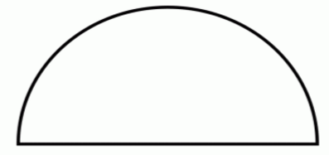
Fractions Made Simple – slide 1
½
½
1 whole

Slide 2
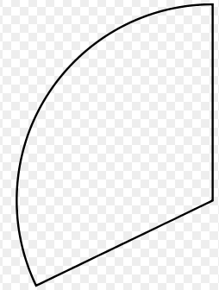
Fractions Made Simple – slide 2
1/3
1 whole
1/3
1/3

Slide 3
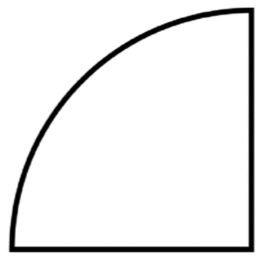
Fractions Made Simple – slide 3
¼
¼
¼
¼
1 whole

Slide 4
Fractions Made Simple – slide 4
1 whole

Slide 5
Fractions Made Simple – slide 5
1 whole

