Slide 1
What you are turning in NOW…
Stapled and IN ORDER:
Lab #1: Microscopic Observations
pre-Lab exercise (man: 28–30; pdf: 6-8),
lab activity and Microscopy (man: 31&32; pdf: 9&10)
Completed but NOT to tear/cut out:
Lab #2: The Scientific Method
pre-Lab exercise (man: 41&42, pdf: 22&23)
You can expect to have Lab #1 back next week

Slide 2
Due NEXT CLASS:
Lab #2: The Scientific Method
pre-Lab exercise (man: 41&42; pdf: 22&23)
lab exercise (Pt II: The Great Pillbug Exp {man: 49-51; pdf: 30-33})
Lab #3: Investigations into Properties of
Solution to check for completion
pre-Lab exercise (man: 62 - 65; pdf: 44 - 47)
Tuesday, February 17
503
501
Thursday, February 19
502
Friday, February 20
506
551
550

Slide 3
Let’s take a sec…
1. Which is larger? A millimeter or a centimeter.
2. Using the METER as our base unit of measurement,
How many places do I move the decimal to find the equivalent:
Centimeter: _________________
Nanometer: _________________
3. How many MILLIMETERS are present in the following measurements:
56 nm: _________________
.13 μm: _________________
http://www.biologyjunction.com/images/safety.gif

Slide 4
Let’s get to WORK!!!
Part I we will work on together!
These for the most part are new concepts. If the class is moving a bit too slow for you, please feel free to look over the next part of the lab or
work on the pre-lab for next week.

Slide 5
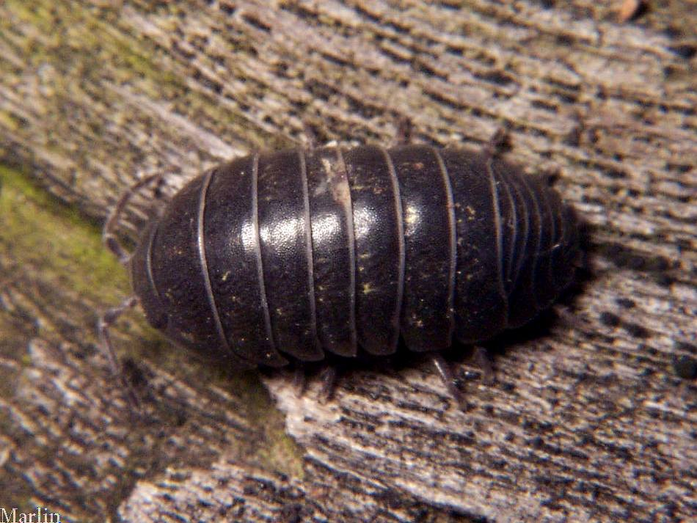
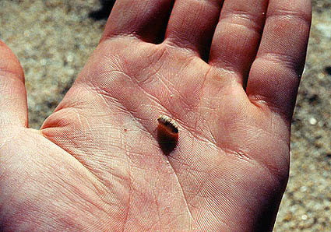
http://www.cirrusimage.com/Isopoda/pillbug_08.jpg
Copyright © 2005 Marine Discovery

Slide 6
Scientific name: Armadillidium vulgare
Kingdom: Animalia
Belongs to the order Isopoda, a family of woodlice
Only crustacean that is able to spend its lifetime on land
Folds itself into a small as a defense mechanism or response to vibration or pressure
Live in wet locations and are often found in damp environments
Have gill-like structures that extract oxygen from its environment; but cannot live under water!

Slide 7
The Great Pillbug Experiment!
Pillbugs are found under objects on damp ground. You might wonder what attracts the pillbugs to that environment – is it the moisture, darkness, or both moisture and darkness, or some other factor?
In this lab you will form and test hypotheses regarding this question.

Slide 8
Hypothesis: Pillbugs are not attracted to or repelled by dark (Null hypothesis)
Experimental Design
Subject: 20 pillbugs
Experimental Variable: Shaded part of the pan
Controlled Variable: Metal pan, atmosphere is dry
Dependent Variable: Migration to a specific part of the pan
Expected/Predicted Result:
There will be a 50/50 ratio of the pillbugs in the dark or the light.
Observed Result:
8 pillbugs went to the light part, 12 pillbugs went to the dark part.

Slide 9
χ² (Chi Square) – Goodness of Fit Test
Statistical analysis is an important tool in academic research
Different ways of calculating/analyzing and interpreting data:
t-test
Analysis of Variance (ANOVA)
Regressional Analysis
χ² (Chi Square)

Slide 10
χ² (Chi Square) – Goodness of Fit Test
Advantages:
Can be used to test the difference between an actual sample (actual data) and hypothetical expectations (expected outcome from a hypothesis)
Used to test the difference between what you expect to find from an experiment, and what you actually find from an experiment
Examine differences in data between categories
Very easy to calculate!!!
Disadvantages:
Can only be used on raw data that is counted (cannot be used for measurements, proportions or percentages)
A type of nonparametric statistics and is not as powerful as other types of statistical methods

Slide 11
χ² (Chi Square) – Goodness of Fit Test
Χ² (Chi Square) = ∑
(Observed Frequency – Expected Frequency)²
Expected Frequency
∑ = expression of a sum of values of variables
Observed frequency = actual data that is observed
Expected frequency = data that is expected

Slide 12
Hypothesis: Pillbugs are not attracted to or repelled by dark (Null hypothesis)
Data:
Expected ratio of light/dark = 10/10
Observed ratio of light/dark= 8/12
Class | Observed Number (O) | Expected Probability | Expected Number (E) | O-E | (O-E)² | (O-E)² E
Light |  | 50%
Dark |  | 50%
Total | 20 | 100% | 20
 |  |  |  |  |  | χ²=
So what does this χ² value mean???

Slide 13
Hypothesis: Pillbugs are not attracted to or repelled by dark (Null hypothesis)
Data:
Expected ratio of light/dark = 10/10
Observed ratio of light/dark= 8/12
Class | Observed Number (O) | Expected Probability | Expected Number (E) | O-E | (O-E)² | (O-E)² E
Light | 8 | 50% | 10 | -2 | 4 | 0.4
Dark | 12 | 50% | 10 | 2 | 4 | 0.4
Total | 20 | 100% | 20
 |  |  |  |  |  | χ²= 0.8
So what does this χ² value mean???

Slide 14
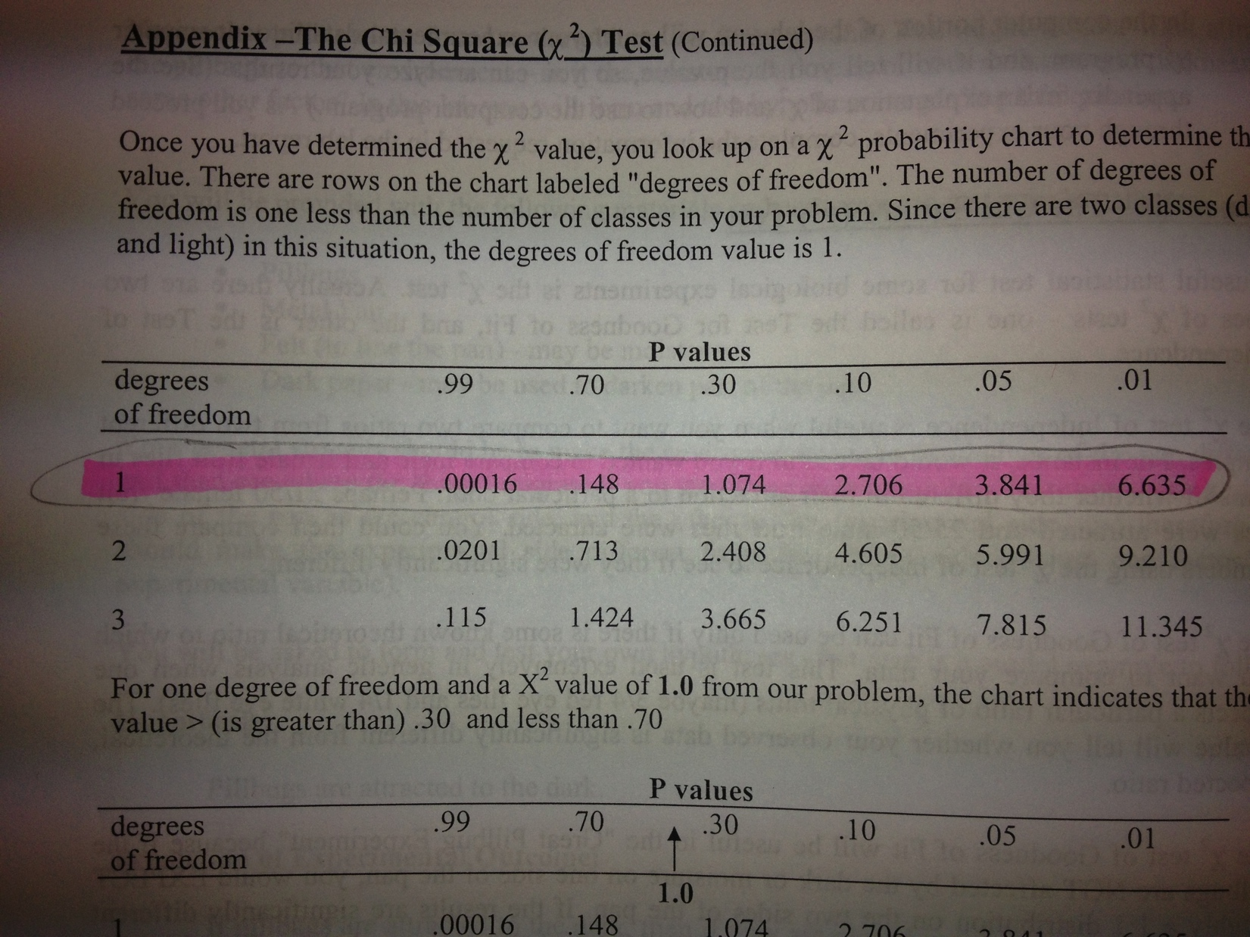

Slide 15
Interpretation of the value is base on χ² Distribution Table:
df (degrees of freedom)
= # of parameters/value that are allowed to vary
= (number of classes – 1)
p-value (probability) = expresses whether the differences between what is observed and what is expected is due to chance
In most cases a p-value less than 5% (p<0.05) describes statistical difference between what is observed and what is expected.
Hypothesis: Pillbugs are not attracted to or repelled by dark (Null hypothesis)
QUESTIONS:
Is there a difference between the number of pillbugs in the light/dark we predicted, and the actual number of pillbugs in the light/dark we observed?
Should be reject or accept our hypothesis?
No. The p-value is greater than 5%. There is no statistical difference between the hypothesis and the observation.
ACCEPT!

Slide 16
Hypothesis: Pillbugs are attracted to the dark.
Experimental Design
Subject: 20 pillbugs
Experimental Variable: Shaded part of the pan
Controlled Variable: Metal pan, atmosphere is dry
Dependent Variable: Migration to the dark part of the pan
Expected/Predicted Result:
All of the pillbugs will stay in the “dark” part of the pan.
Observed Result:
8 pillbugs went to the light part, 12 pillbugs went to the dark part.

Slide 17
Hypothesis: Pillbugs are attracted to the dark.
Data:
Expected ratio of light/dark = 0/20
Observed ratio of light/dark= 8/12
Class | Observed Number (O) | Expected Probability | Expected Number (E) | O-E | (O-E)² | (O-E)² E
Light |  | 0%
Dark |  | 100%
Total | 20 | 100% | 20
 |  |  |  |  |  | χ²=
So what does this χ² value mean???

Slide 18
Hypothesis: Pillbugs are attracted to the dark.
Data:
Expected ratio of light/dark = 0/20
Observed ratio of light/dark= 8/12
Class | Observed Number (O) | Expected Probability | Expected Number (E) | O-E | (O-E)² | (O-E)² E
Light | 8 | 0% | 0 | 8 | 64 | 0
Dark | 12 | 100% | 20 | -8 | 64 | 3.2
Total | 20 | 100% | 20
 |  |  |  |  |  | χ²= 3.2
So what does this χ² value mean???

Slide 19
Interpretation of the value is base on χ² Distribution Table:
df (degrees of freedom)
= # of parameters/value that are allowed to vary
= (number of classes – 1)
p-value (probability) = expresses whether the differences between what is observed and what is expected is due to chance
In most cases a p-value less than 5% (p<0.05) describes statistical difference between what is observed and what is expected.
Hypothesis: Pillbugs are attracted to the dark
QUESTIONS:
Is there a difference between the number of pillbugs in the light/dark we predicted, and the actual number of pillbugs in the light/dark we observed?
Should be reject or accept our hypothesis?
Yes; but the p-value is greater than 5%. There is not enough statistical difference between the hypothesis and the observation.
REJECT!

Slide 20
Let’s get to WORK!!!
Part II you will work on without my direct assistance. If/when you have any questions, be sure to ASK!
I might not give you the answer you wanted, but I’ll certainly help you in the thinking process…

Slide 21
Hypothesis #3
When you “Develop a Hypothesis of Your Choosing”, what do you have to be sure you keep in mind with your manipulated (independent) variable?

