Slide 1
Part I: DNA Fingerprinting
Variations in DNA sequences between individuals as determined by differences in restriction enzyme cleavage patterns are known as Restriction Fragment Length Polymorphisms (RFLPs). A particular RFLP pattern represents the unique DNA fingerprint of an individual.

Slide 2
Part I: DNA Fingerprinting
RFLP visual aid
http://highered.mcgraw-hill.com/olc/dl/120078/bio20.swf

Slide 3
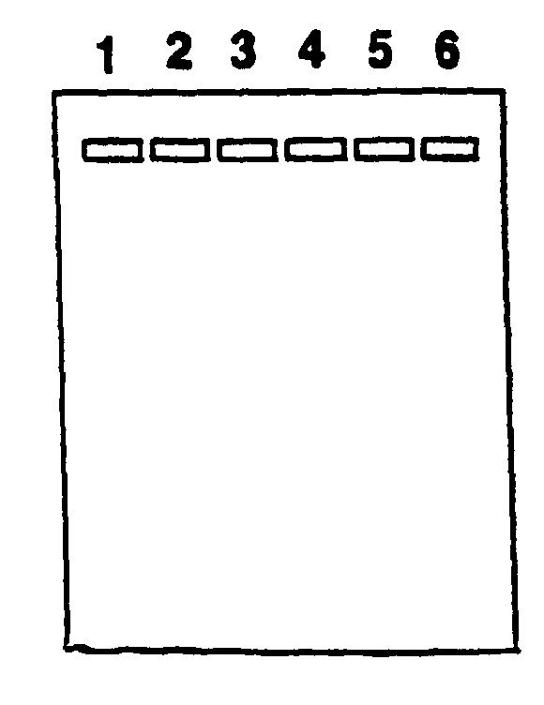
Part I: DNA Fingerprinting
Load the DNA samples into wells in the gel as follows:
(the tubes with the DNA will be lettered A ‑ F)
Well Tube DNA
1 A Crime scene DNA cut with Enzyme 1
2 B Crime scene DNA cut with Enzyme 2
3 C Suspect 1 DNA cut with Enzyme 1
4 D Suspect 1 DNA cut with Enzyme 2
5 E Suspect 2 DNA cut with Enzyme 1
6 F Suspect 2 DNA cut with Enzyme 2

Slide 4
Part II: DNA Spooling
DNA is a long helical molecule which dissolves in water, but will come out of solution in alcohol. Because of these characteristics it is possible to precipitate DNA out of solution with ethanol and then to wind masses of DNA molecules around a glass rod, and see the DNA with the naked eye. This process is called DNA spooling, and is often used as a step toward purifying DNA.

Slide 5
Part II: DNA Spooling
Carefully slice a small section (4 – 5 grams) of onion tissue (or other plant tissue you brought in) from the main body of the onion and place into a mortar.
Pipet 3 ml of DNA extraction buffer into the mortar. Grind the tissue to release the cellular contents, including the DNA, from the plant cells.
Place a square of cheese cloth into a funnel and filter the contents into a clean tube. Use about 2 ml of the liquid cell extract.
Carefully pour 2ml of cold 95% isopropanol over the liquid cell extract.
Place a glass rod into the test tube and twirl it at the interface of the two
liquids. The DNA should begin to spool (wrap) around the glass rod.
Gently lift the class rod out of the solution periodically to observe the DNA material attached.
7. Optionally, you may place the DNA on a microscope slide and stain with
methylene blue. Cover with a cover slip. You will see fibers that are made up
of hundreds of DNA molecules.

