Slide 1
Lab days
Tues
503
0830
Thurs
501
1230
550
1830
551
1830
502
1230
Fri
506
1100

Slide 2
Looking at NOW:
Lab #1:
Microscopic Observations

Slide 3
Due NEXT CLASS:
Lab #1: Microscopic Observations
~Pre-Lab exercise (p28 – 30);
~Completed lab responses & Responses to Microscopy
(p31 & 32 – use the pre-lab information and the internet)
Lab #2: The Scientific Method
Pre-Lab exercise (p 41 & 42)
Tuesday, February 3
503
501
Thursday, February 5
502
Friday, February 6
506
551
550

Slide 4
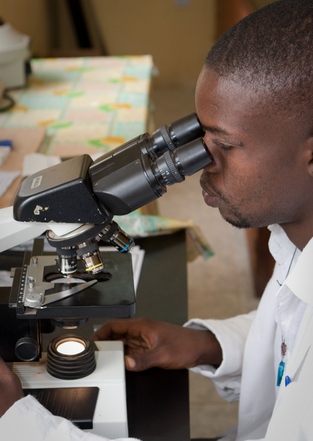
Lab #1
Microscopic Observations
Objectives:
Observe the following prepared slides under the microscope:
Hydra
Lily Leaf Epidermis
Amoeba
Calculate the total magnification used to observe these specimen
Prepare a wet-mount slide
http://helpingchildrenworldwide.org/wp-content/uploads/2013/02/close-up-of-man-looking-through-microscope-USED.jpg

Slide 5
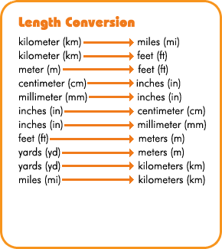
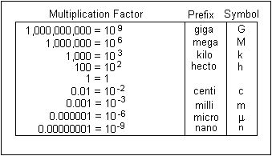
Units of length…
http://www.learner.org/interactives/metric/length.html
http://www.bgsu.edu/departments/chem/faculty/leontis/chem109/Metric.html
…using the
English system
…using the
Metric system
YAY METRIC!!!

Slide 6
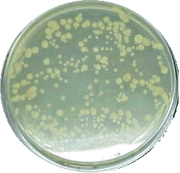
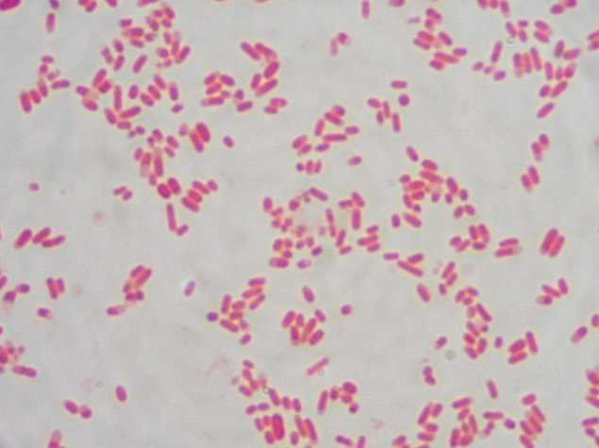
The resolving power of a basic microscope is between
0.1 μm to 0.2 μm...
http://www.sciencehound.com/science_project_community/node/5333
…that’s a thousandth
of a millimeter!!!
http://biology.clc.uc.edu/fankhauser/labs/microbiology/gram_stain/Gram_stain_images/index_gram_stain_images.html

Slide 7
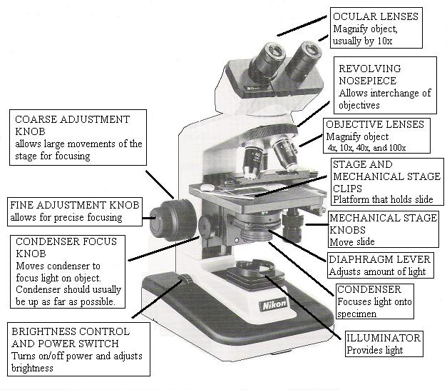
Your Microscope; sort of…

Slide 8
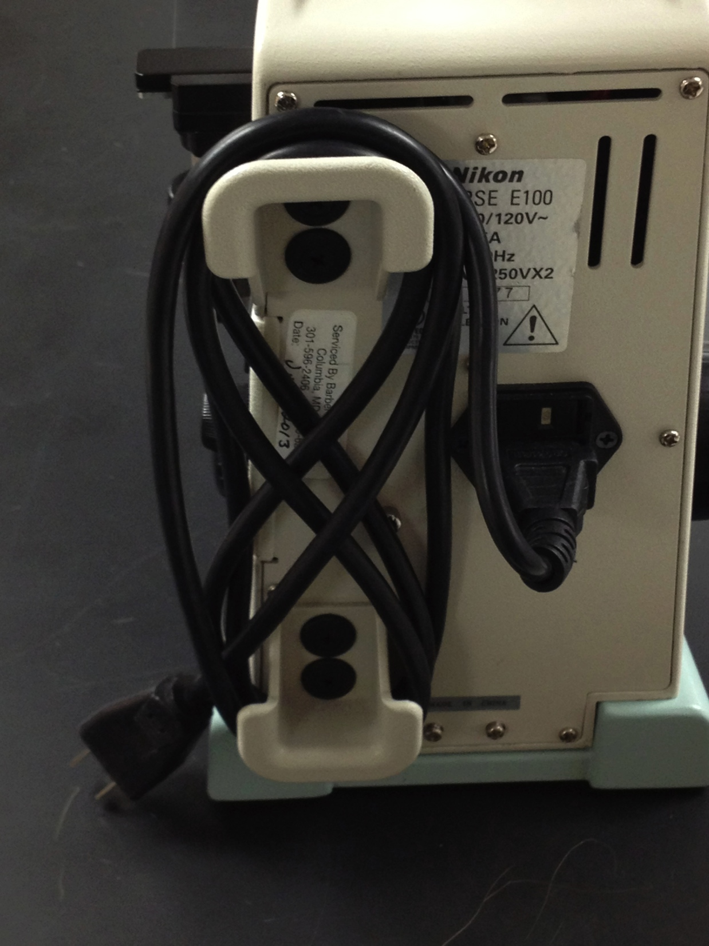
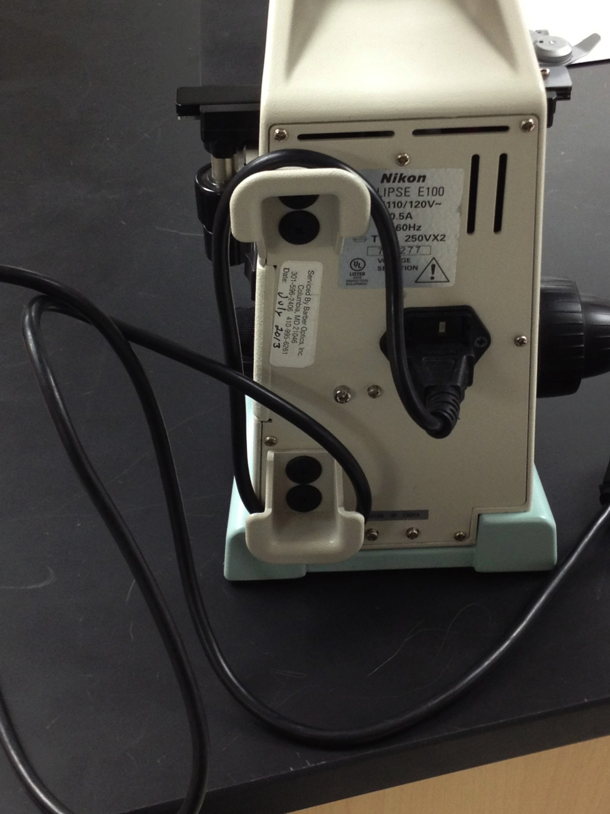
Parts/Storage of a Microscope:

Slide 9
Parts/Storage of a Microscope:

Slide 10
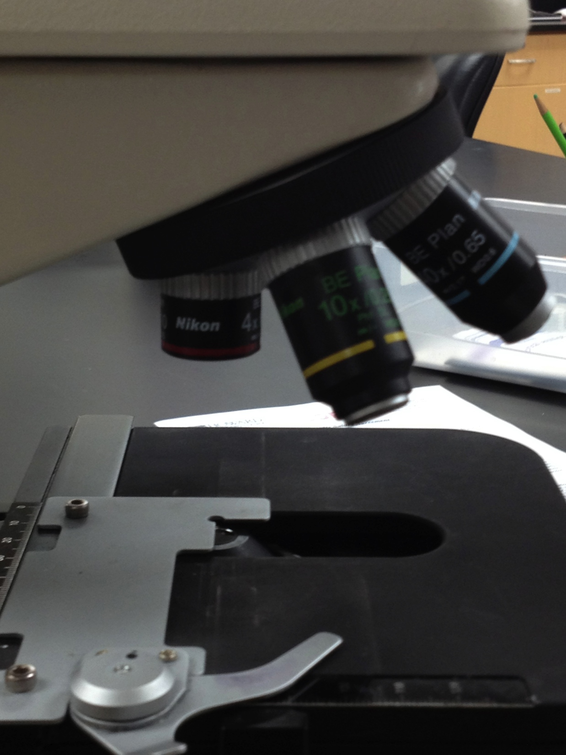
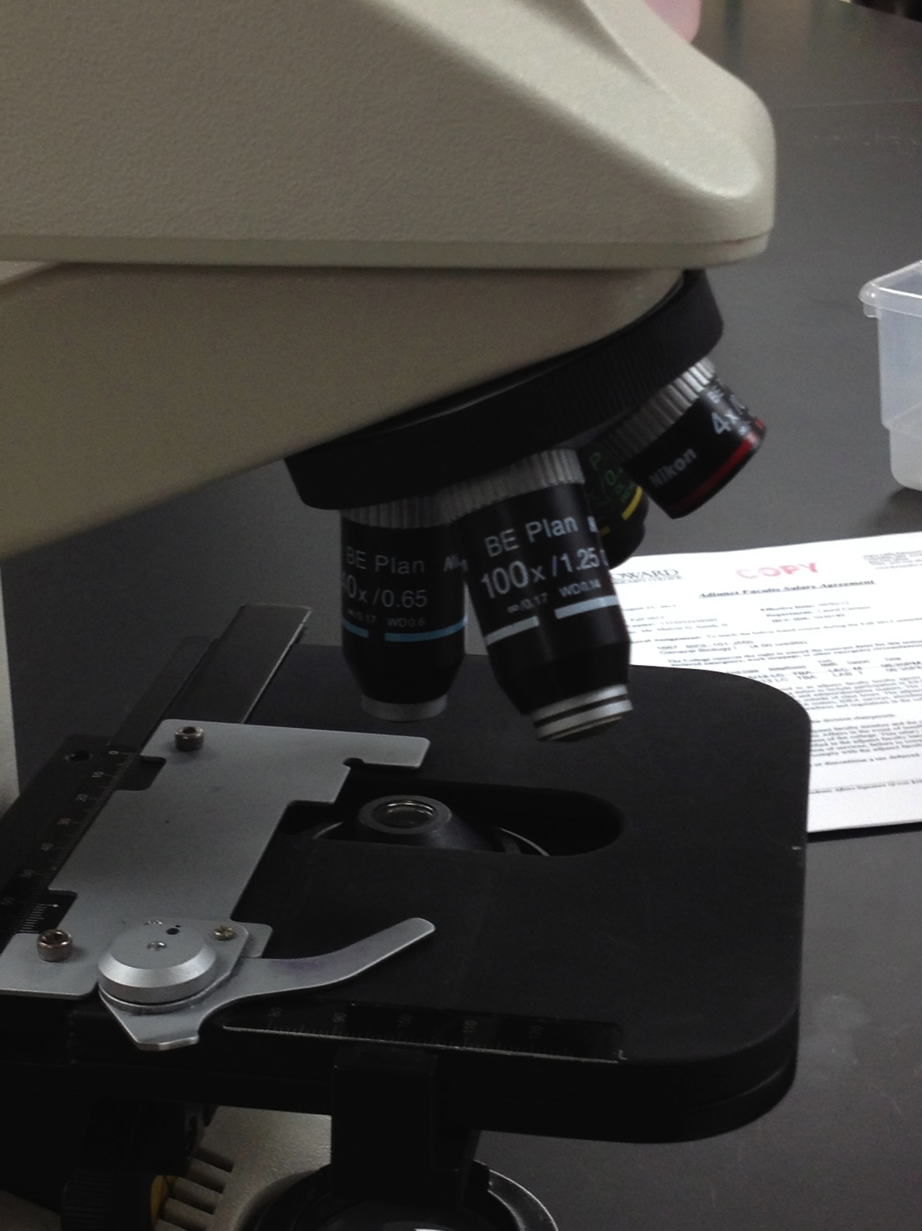
Parts/Storage of a Microscope:
Nosepiece

Slide 11
Parts/Storage of a Microscope:

Slide 12
Parts of a Microscope:
Red stripe= 4x
Yellow stripe= 10x
Blue stripe= 40x

Slide 13
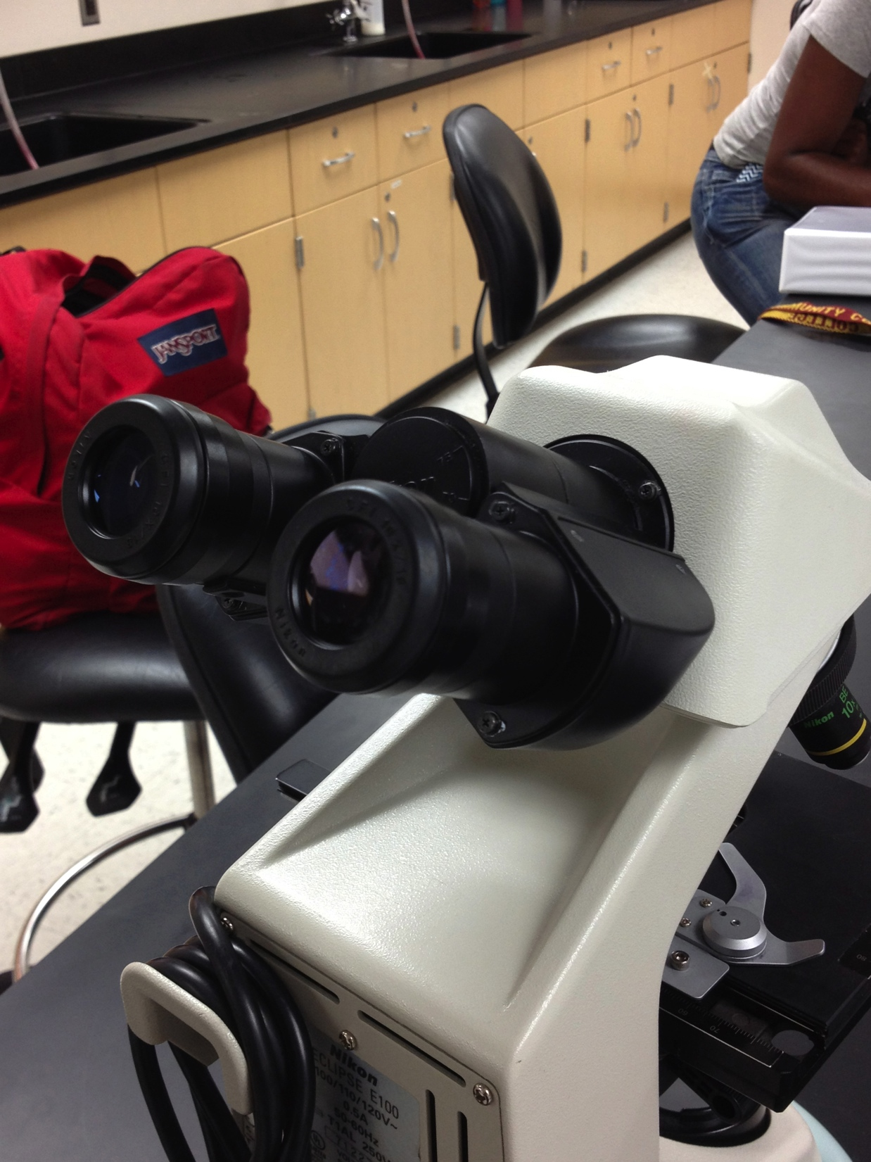
Parts of a Microscope:
Ocular Lenses (eyepieces)
10x magnification
This does NOT mean with two of them it magnifies 100x

Slide 14
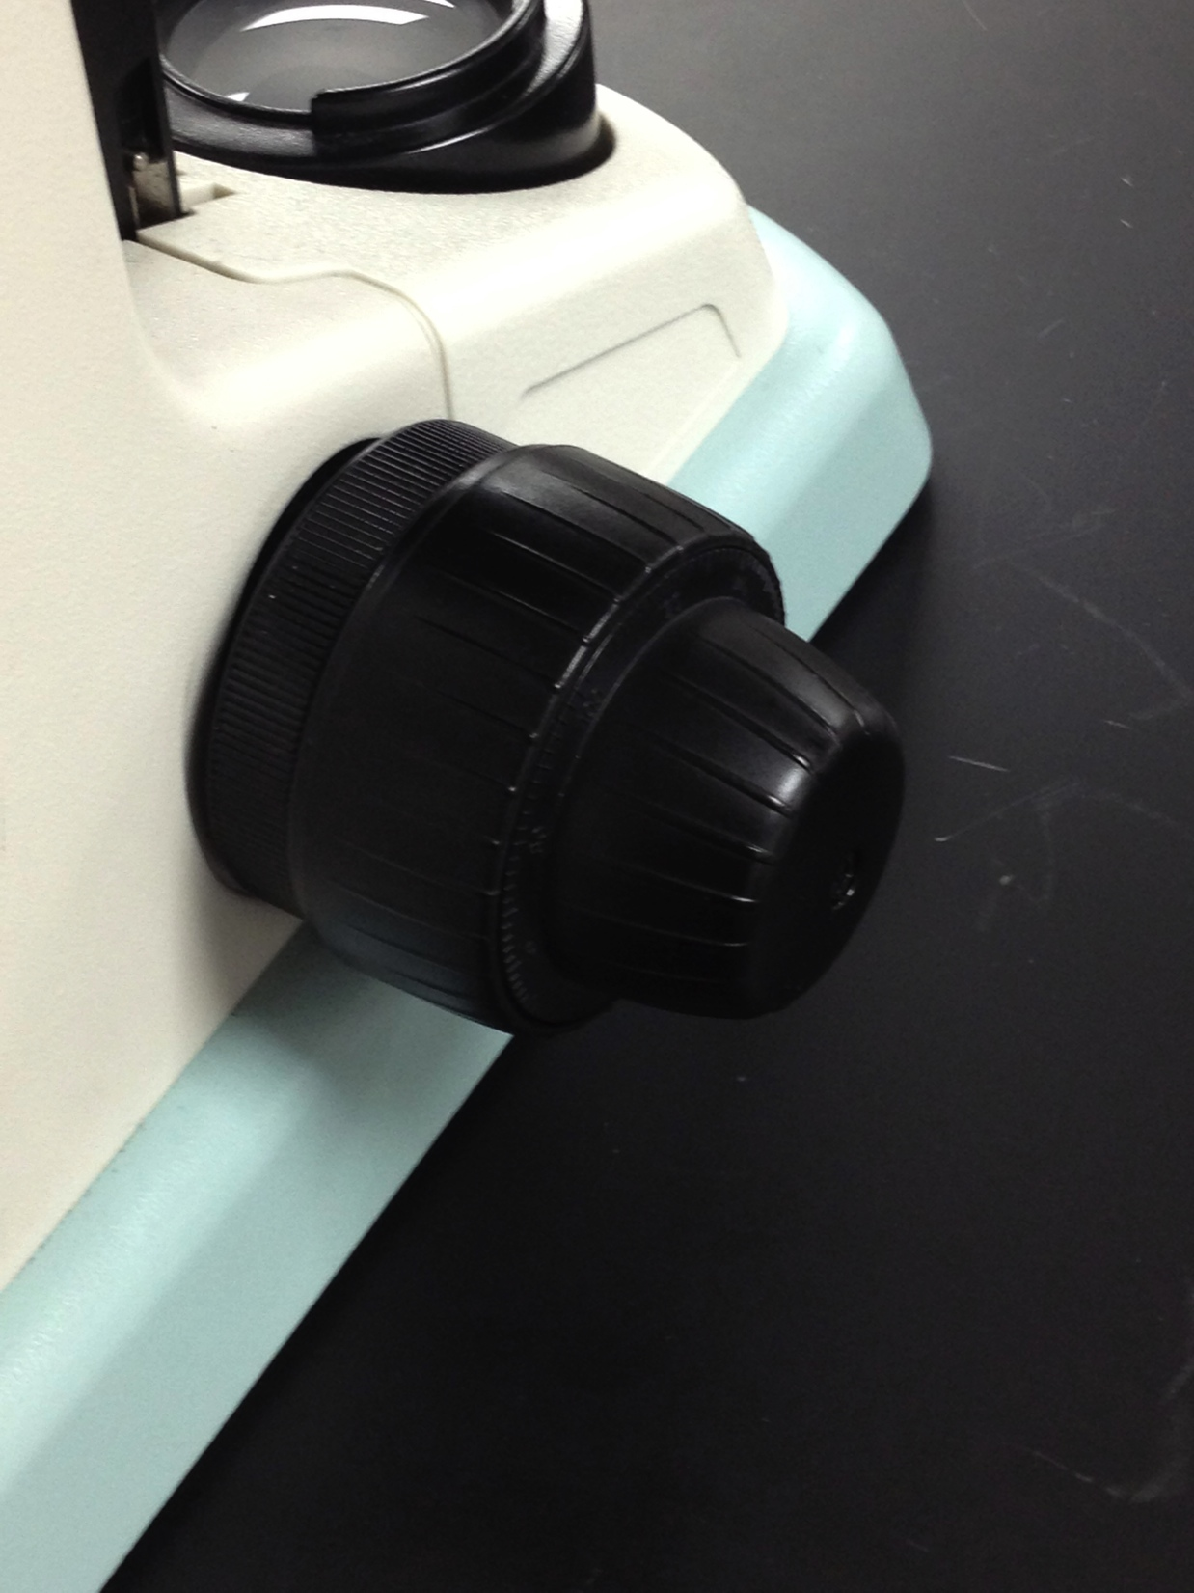
Parts of a Microscope:
Adjustment Knobs
Course Adjustment: used for large stage movements (ONLY used with 4x objective lens)
Fine Adjustment:
for precise focusing

Slide 15
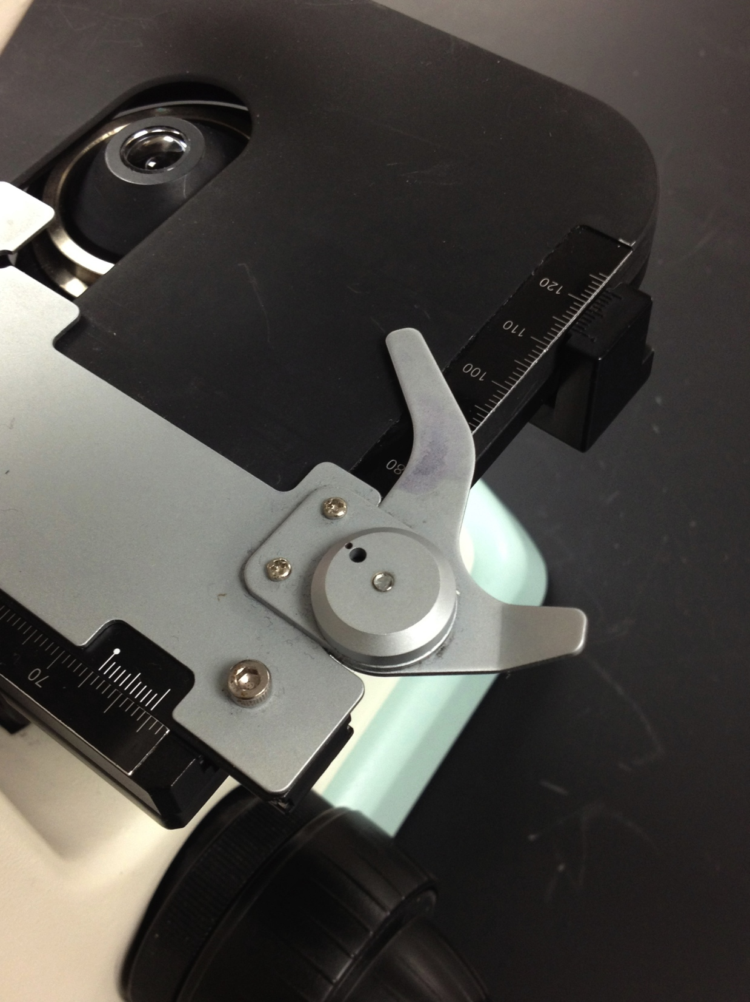
Parts of a Microscope:
Stage
and
Stage Clip

Slide 16
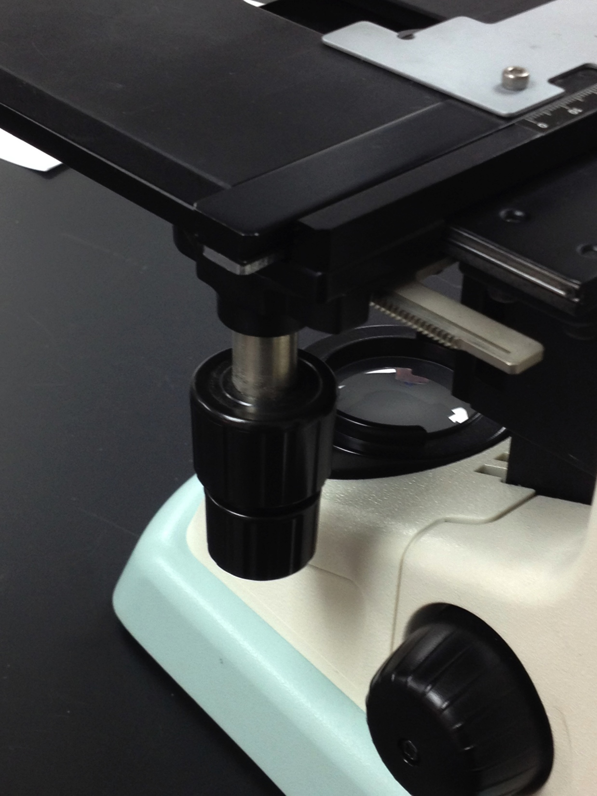
Parts of a Microscope:
Mechanical Stage Knobs
Moves the specimen into field of view
(so you DON’T handle the stage!)
THESE DO NOT FOCUS THE SPECIMEN

Slide 17
Storage of a Microscope:
1- using the nosepiece, turn until 4X (red stripe) objective lens is pointing towards the stage
2- turn the coarse adjustment knob until the stage is all the way down
This ALSO needs to be done whenever you change
your specimen slide!!!

Slide 18
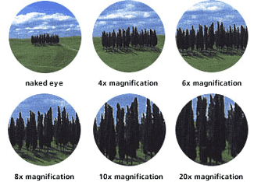
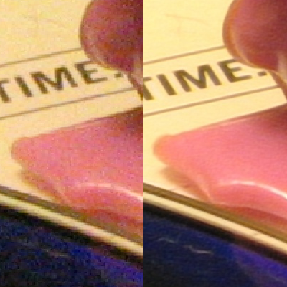
Things to remember about the microscope:
Magnification – “increases” the size object
Resolution – the “clarity” of the object
http://www.riflescopes.webyshops.com/Tech-Talk/Magnification
Total magnification = objective lens x ocular lens
Omegatron

Slide 19
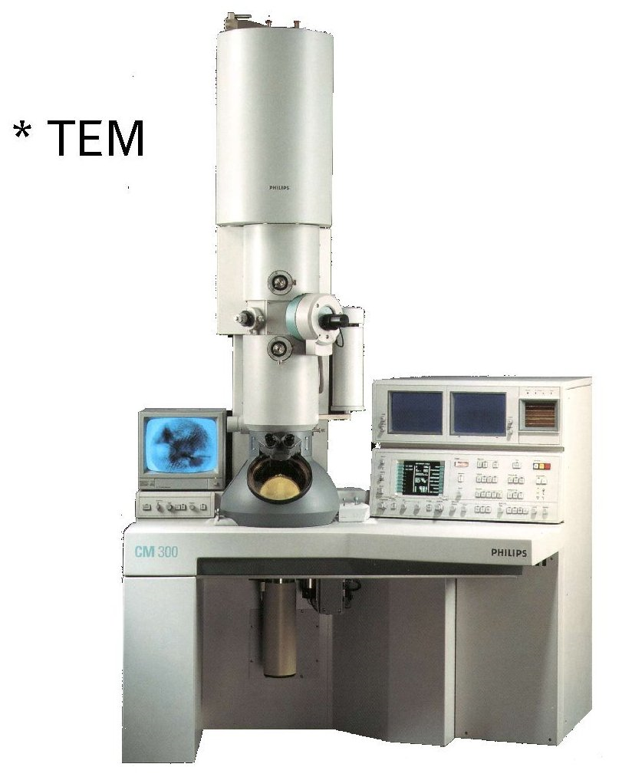
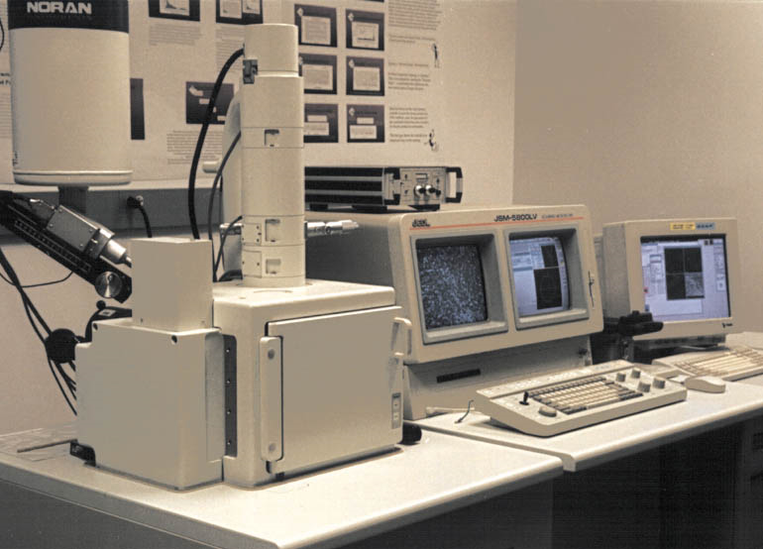
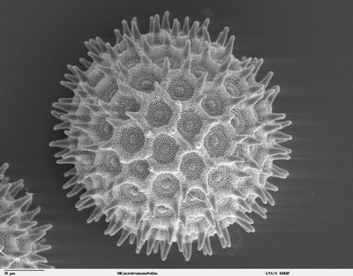
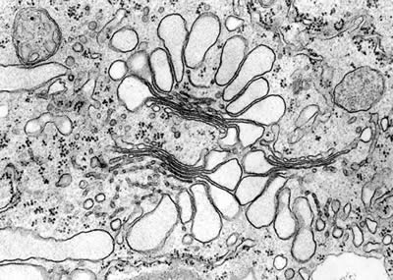
TEM
SEM
http://serc.carleton.edu/research_education/geochemsheets/techniques/SEM.html
http://serc.carleton.edu/research_education/geochemsheets/techniques/SEM.html
http://www.brookes.ac.uk/lifesci/research/groups/researchimages/plantcellbiologyimage/golgitem
http://bayblab.blogspot.com/2008/07/sem-pics.html

Slide 20
Obtain a clean deep well slide
Add 1 small drop of pond organism directly on the middle of the slide depression (well)
Place a clean cover slip on the depression (well)
Dab the corners with kimwipes – DO NOT USE AN OVERLY “WET” SLIDE
Wash AND dry slides after use and place
back in bins.
These slides are very expensive and cannot be thrown away!!!

Slide 21
Let’s get to WORK!!!
If/when you have any questions, be sure to ASK! I might not give you the answer you wanted, but I’ll certainly help you in the thinking process…
…and YES! You clean up after YOURSELF!!!

Slide 22
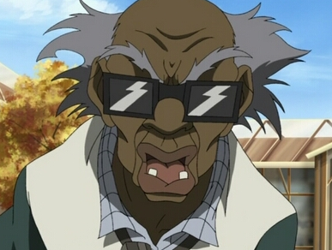
Don’t make my inner
Stinkmeaner come out
http://i.cdn.turner.com/asfix/repository//8a25c3920eaf5fa6010eafc3fecd017e/bndocks_ep104_03.jpg

Slide 23
Due NEXT CLASS:
Stapled and IN ORDER:
Lab #1: Microscopic Observations
~Pre-Lab exercise (p 28 – 30);
~Completed lab responses (p 31) & Responses to Microscopy
(p 32 – use the pre-lab information and the internet)
Completed but NOT to tear/cut out:
Lab #2: The Scientific Method
Pre-Lab exercise (p 41 & 42)

