Slide 1
What you are doing NOW…
Turning in, stapled and IN ORDER:
Lab #3: Investigations into Properties of Solution pH and Conductivity
pre-lab exercise (62-65) and lab
exercises with review questions (66-68)
Sticker for completed work but NOT to tear out:
Lab #4: What’s in Our Food?
pre-lab exercise to check for completion (75-77)

Slide 2
Due Next Week
Lab #4: What’s in Our Food?
Pre-Lab exercise (75-77) & responses to Lab Questions (79-82)
Lab #5: Dissection of the Fetal Pig
Pre-Lab exercise to check for completion (89)
Extra credit Nutrition work
Tuesday, March 3
503
501
Thursday, March 5
502
Friday, March 6
506
551
550

Slide 3
Part I: Testing Different Macromolecules
Know how each macromolecule tests positive or negative for a specific test
Part II: Testing Different Foods
Use the same tests from Part I to test two foods
Use two tests from Part I to test the same food
Part III: Testing Lactaid
Determine if a sample of lactaid is still good for lactose-intolerance individuals

Slide 4
Activity I: Testing for organic molecules
Testing for Simple Sugars (also reducing sugars)
Test: Benedict’s Test
Tube 1: Tube 2:
5 mL water 5 mL water
20 drops of water 20 drops of 4% glucose solution
20 drops of Benedict’s Reagent 20 drops of Benedict’s Reagent
Heat for 5-10 minutes Heat for 5-10 minutes
Which is the positive control?
Which is the negative control?

Slide 5
Fructose
Glucose
What do the both of these have in common?

Slide 6
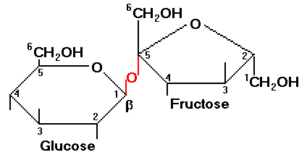
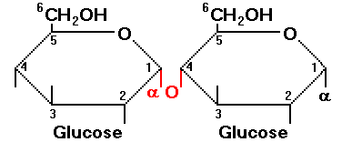
Non-reducing sugar
Reducing Sugar
http://www.rpi.edu/dept/chem-eng/Biotech-Environ/FUNDAMNT/sugpoly.htm

Slide 7
II. Testing for the presence of starch
Test: Potassium Iodide (Lugol’s Solution)
Tube 1 Tube 2
5 mL of water 5 mL of water
4 drops of KI 4 drops of KI
10 drops of water 10 drops of 2% starch
(shake starch first!!!)

Slide 8
III. Testing for the presence of lipids
Sudan IV Stain
Tube 1 Tube 2
5 mL of water 5 mL of water
A pinch of Sudan IV A pinch of Sudan IV
10 drops of water 10 drops of vegetable oil
Try mixing your tube 1 and tube 2 together.
Which layer does the Sudan IV stain?

Slide 9
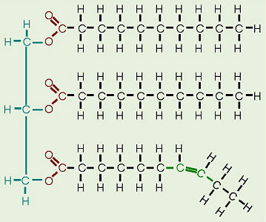
Sudan IV dissolves in the fatty acid part of any lipids. This fatty part of lipid is .
hydrophobic
http://biology.clc.uc.edu/graphics/bio104/fat.jpg

Slide 10
IV. Testing for proteins
Sodium hydroxide and Copper sulfate test:
these tests for the presence of a peptide bond
Tube 1 Tube 2
5 mL of water 5 mL of water
20 drops of NaOH 20 drops of NaOH
20 drops of CuSO4 20 drops of CuSO4
10 drops of water 10 drops of albumin
Shake Shake
Which is the positive control? Which is the negative control?
http://www.peptideguide.com/images/peptide-bond.gif

Slide 11
V. Testing for Vitamin C
Indophenol Solution
Tube 1 Tube 2
20 drops of indophenol 20 drops of indophenol
10 drops of Vitamin C/ascorbic acid 10 drops of water
Which is the positive control? Which is the negative control?

Slide 12
Activity II: Test the types of organic molecules in your every day food.
You can choose to test TWO different foods and test the organic molecule base on what you think they should test positive for.
Ex. Test a lunch meat for proteins and cereal for simple sugars.
You can choose to test ONE food for TWO types of organic molecules it should test positive for.
Ex. Test a lunch meat for fats and proteins.
You need to crush the food and suspend it in water. Boil the suspension for a minute or two to release the nutrients into the solution.

Slide 13
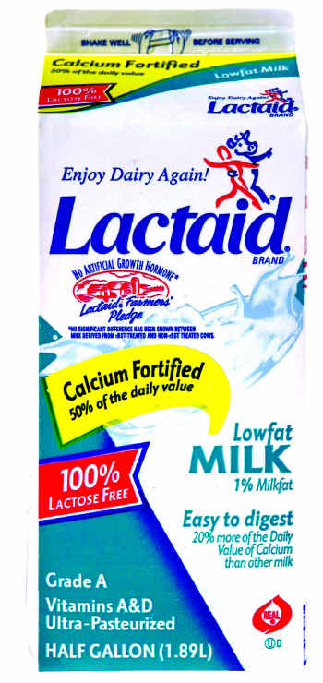
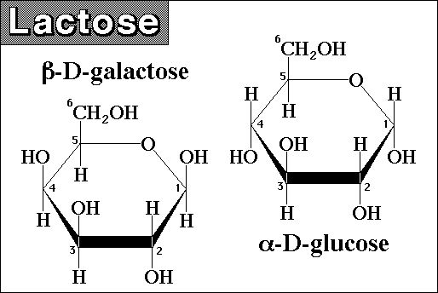
Activity III: Testing for lactose
Lactose is a disaccharide of two simple sugars: glucose and galactose.
The enzyme lactase cleaves the bonds that hold these two simple sugars during digestion.
Individuals that do not produce lactase are unable to tolerate lactose.
In the past few years, milk companies have produced lactose-free milk (Lactaid). In this milk, the lactose sugar has been pre-hydrolyzed by the enzyme lactase.
http://www.hcc.mnscu.edu/chem/V.25/lactose_1.jpg
http://www.dentonrc.com/sharedcontent/dws/img/v3/02-05-2008.NH_05lactaid.G8P2B3PPM.1.jpg

Slide 14
There’s A LOT to do, but the procedures are not too difficult…
“simply” pay attention to your procedures
and be sure to record your results.
Let’s get to WORK!!!

