Slide 1
What you are turning in NOW…
Lab #7: The Plant and Animal Kingdom
Pre-Lab exercise for accuracy (117),
Lab Questions (118, 120, & 122)
Lab #8: Photosynthesis
Pre-Lab exercise to check for
completion (131 - 133)

Slide 2
Due next Week!!!
Lab #8: Photosynthesis
Pre-Lab exercise to check for completion (131 - 133)
Lab Questions (134 – 136)
Lab #9: The Cell Cycle
Pre-Lab exercise for accuracy (145 & 146),

Slide 3
Overall Photosynthesis Reaction:
CO₂ + H₂O + light C₆H₁₂O₆ + O₂
(inorganic molecules)
(organic)
Light Dependent Reaction
Products: Oxygen, NADPH and ATP
Occurs in the thylakoid
Light Independent Reaction
Products: carbohydrates
Occurs in the stroma

Slide 4
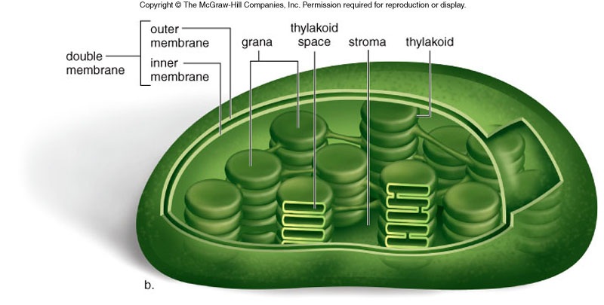
Figure 4.16b
The chloroplast is the site of photosynthesis in plants. Some organisms that have chlorophyll can also photosynthesize, even if they do not have chloroplasts.
Notes:
Figure 4.16b

Slide 5
Chlorophyll
THE photosynthetic pigments in plants
small, green pigments that are activated during the light dependent reaction
Part I: Visualizing photosynthetic pigments through chromatography
http://www.youtube.com/watch?v=u6jD0hJO-28&feature=related
http://www.youtube.com/watch?v=THqmpLdUaBA

Slide 6
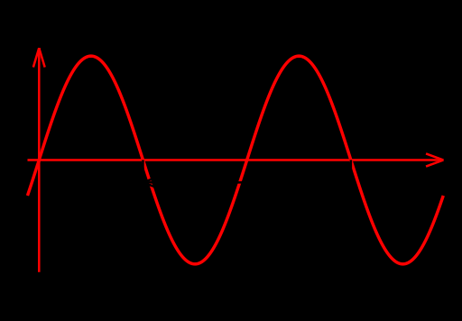
Chlorophyll
THE photosynthetic pigments in plants
small, green pigments that are activated during the light dependent reaction
Part II: Using a spectrophotometer to plot the absorption spectrum of chlorophyll
Light is a form of an electromagnetic radiation. This type of radiation (or energy) travels and scatters in space. The energy of electromagnetic radiation is exhibited in two forms:
Photon:
discrete bundle of energy or particles of energy
Frequency/Wavelength:
When light travels, it travels in wavelengths that can be measured. The unit used to measure the frequency of light is in nanometers (nm).

