Slide 1
What you are turning in NOW…
Lab #8: Photosynthesis
Pre-Lab exercise accuracy (131 - 133)
Lab Questions (134 - 136)
Lab #9: The Cell Cycle {to look over}
Pre-Lab exercise for completion
(145 &146)

Slide 2
Due next class!!!
Lab #9: The Cell Cycle
Pre-Lab exercise for accuracy (131 & 132)
Lab Questions (133)
Lab #10: Genetics
Pre-Lab exercise for accuracy (140 & 144)

Slide 3
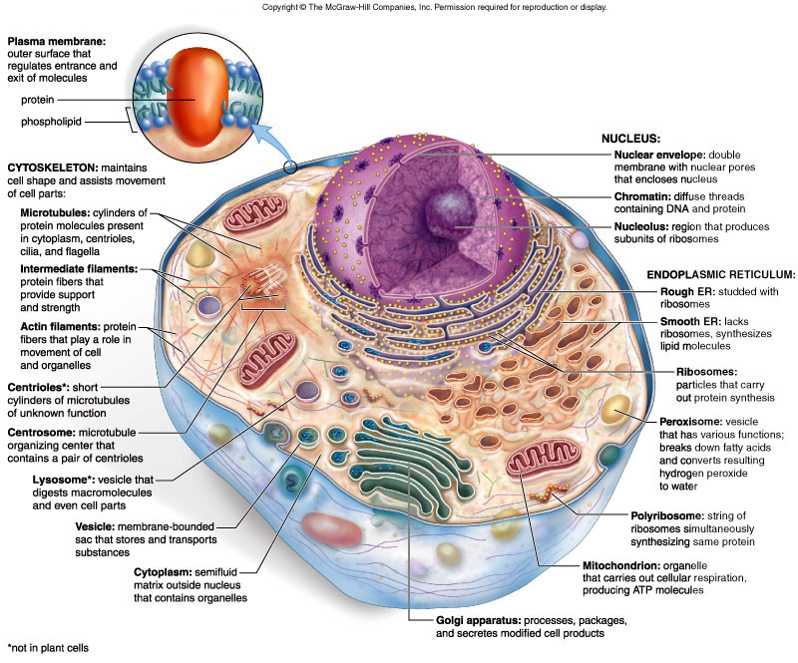

Slide 4
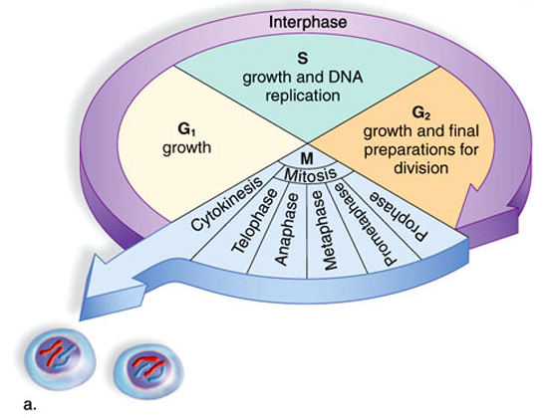
Lab 10 The Cell Cycle Lab
Interphase
The period of time between mitotic divisions
Growth period, preparation period
Mitosis
Duplicated chromosomes separate into two nuclei, each with the same genetic information as the parent cell’s; division of the chromosomes
Cytokineses/
Cell Division
- Cytoplasmic division of the actual cell

Slide 6
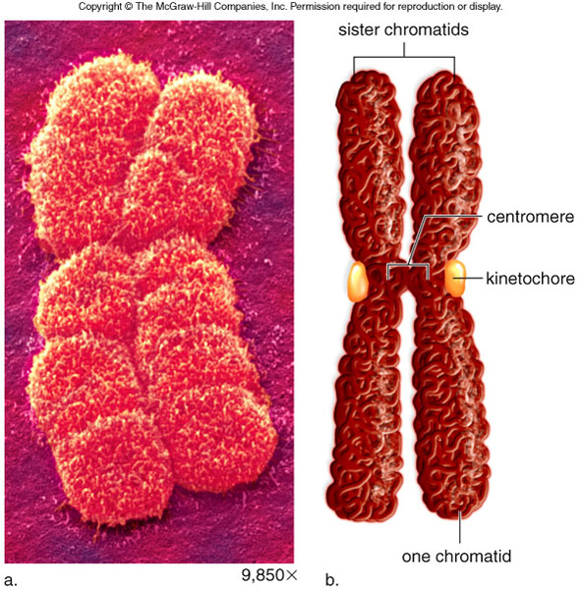
Figure 9.3

Slide 7
INTERPHASE
Description?
PROPHASE
METAPHASE
ANAPHASE
TELOPHASE

Slide 8
INTERPHASE
PROPHASE
METAPHASE
ANAPHASE
TELOPHASE

Slide 9
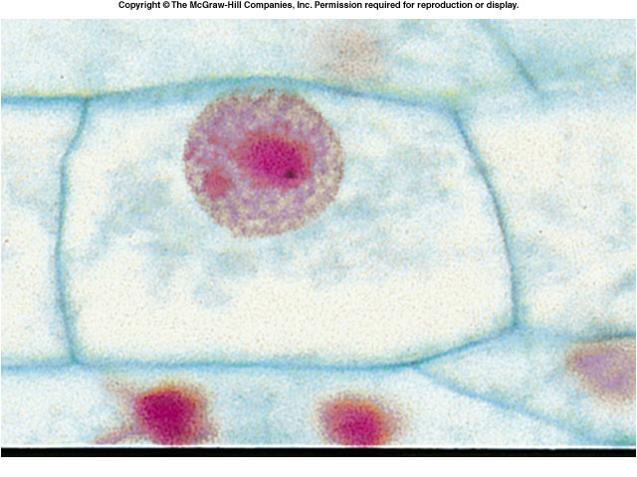
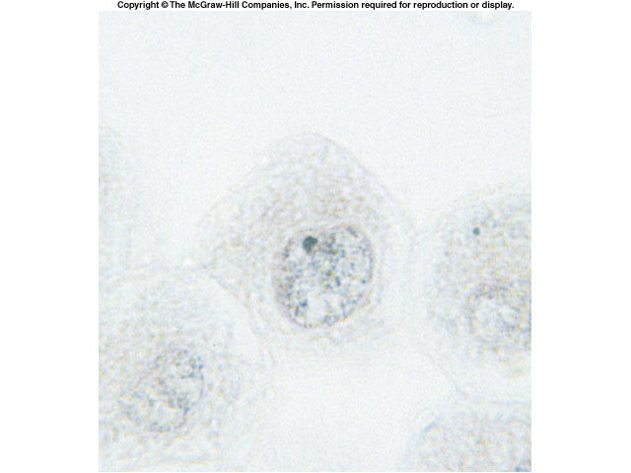
Plant Cell Interphase
Animal Cell Interphase

Slide 10
INTERPHASE
INTERPHASE
Description?
PROPHASE
METAPHASE
ANAPHASE
TELOPHASE

Slide 11
INTERPHASE
PROPHASE
METAPHASE
ANAPHASE
TELOPHASE

Slide 12
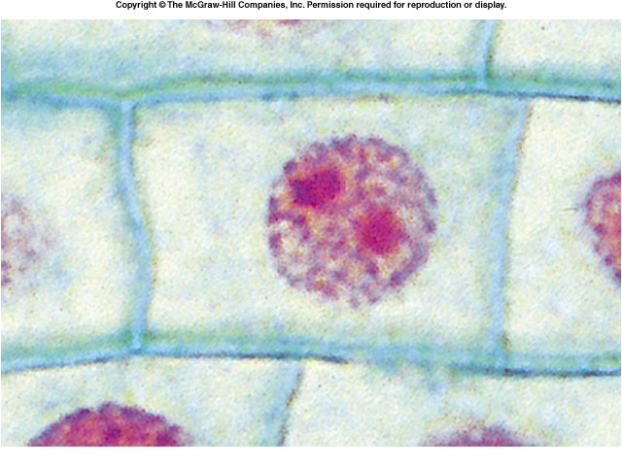
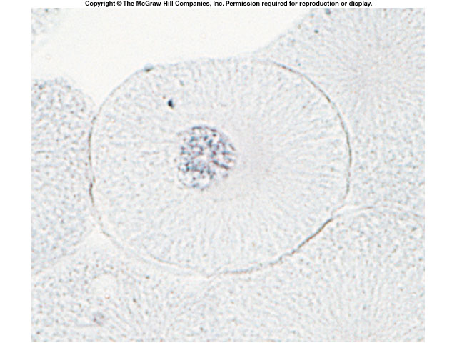
Plant Cell Prophase
Animal Cell Prophase
Chromatin is thicker.
Nuclear envelope starts to disintegrate.
Plant Cell Interphase
Animal Cell Interphase

Slide 13
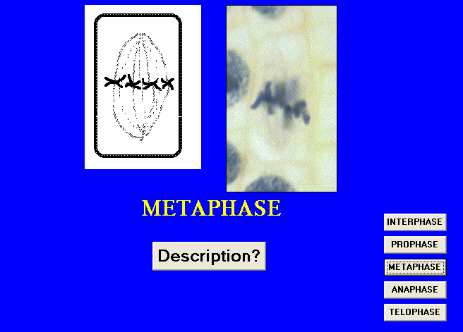
INTERPHASE
PROPHASE
Description?
METAPHASE
ANAPHASE
TELOPHASE

Slide 14
INTERPHASE
PROPHASE
METAPHASE
ANAPHASE
TELOPHASE

Slide 15
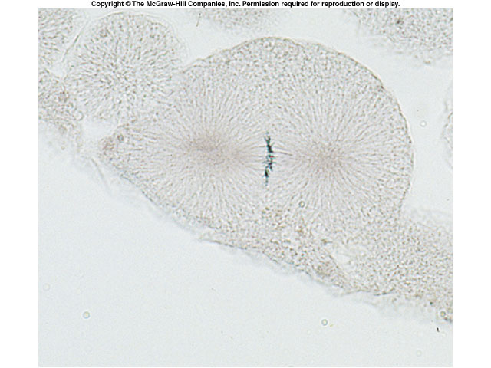
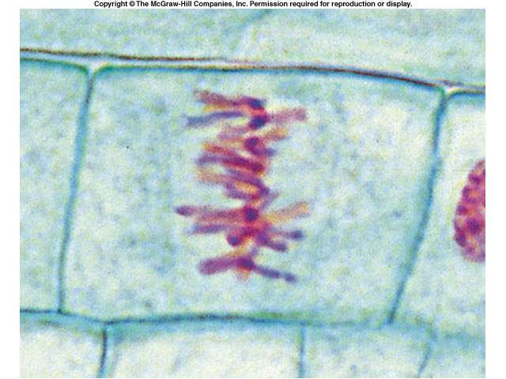
Plant Cell Metaphase
Animal Cell Metaphase
“Meta” = middle

Slide 16
INTERPHASE
Description?
PROPHASE
METAPHASE
ANAPHASE
TELOPHASE

Slide 17
INTERPHASE
PROPHASE
METAPHASE
ANAPHASE
TELOPHASE

Slide 18
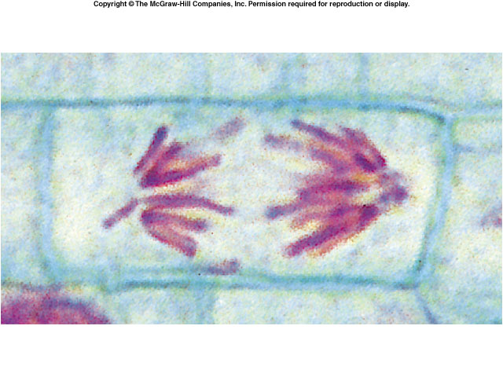
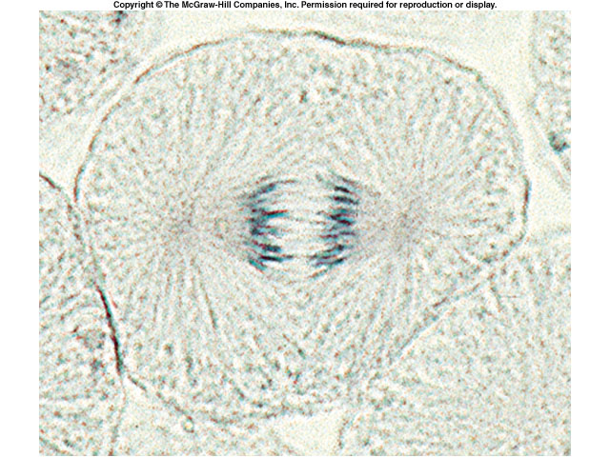
Plant Cell Anaphase
Animal Cell Anaphase
“Ana” = upward
Anaphase during mitosis is lateral.

Slide 19
INTERPHASE
PROPHASE
Description?
METAPHASE
ANAPHASE
TELOPHASE

Slide 20
INTERPHASE
PROPHASE
METAPHASE
ANAPHASE
TELOPHASE

Slide 21
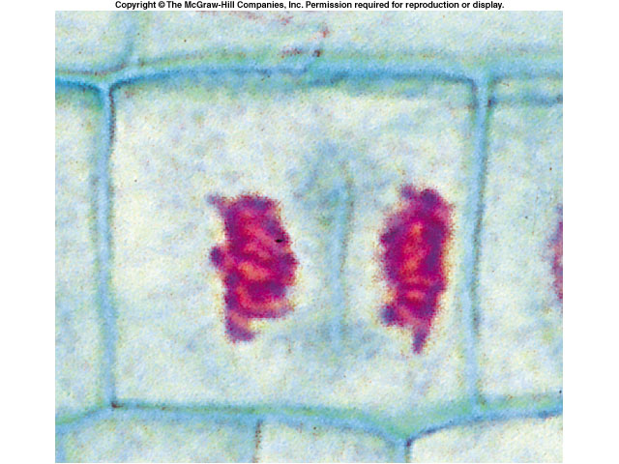
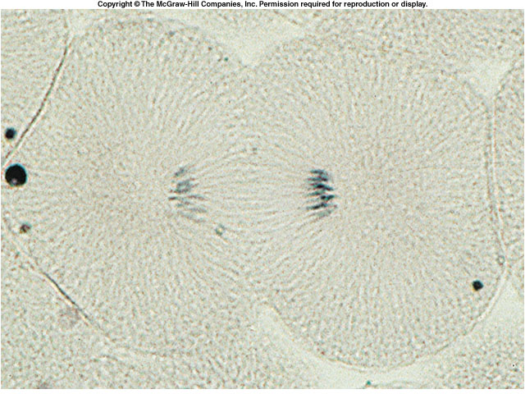
Plant Cell Telophase
Animal Cell Telophase
“Telo” = end

Slide 22
Cytokinesis
Last stage of the cell cycle
Physical division of the cell
“Cyto” = cell
“Kinesis” = division
Division of the cytoplasm: organelles, cytoskeleton
Mitosis = division of the chromosomes!
Plants and animals cells undergo cytokinesis differently. Although both types of cells undergo similar mitosis steps, they differ in how the cells physically divide.

Slide 23
Animal Cell Cleavage Furrow
Plant Cell Plate Formation

Slide 24
Part I: Preparation and observation of onion
root tip cells
Look for the different stages of mitosis in your onion root cells
Draw these stages as you view them under the microscope
Add onion tips
for 5 mins in HCl
Transfer onion root tips to carnoy solution for 4 mins
6 M HCl
Carnoy Fluid
Transfer tips on slide and add a drop of Toluidine blue. Blot excess dye with kimwipe.
Add a drop of water, cover and view under microscope.

Slide 25
Part II: Cytokinesis in Animal Cells
Observe a prepared slide of whitefish blastula
Draw what you see from your observation
BE SURE to be able to compare and contrast the plant and animal cells!!!

Slide 26
Part III: Bacteria Genetics (for next week!)
Inoculate E. coli bacteria on agar plates.
Take two plates from where Mr. Smith tells you they are stored:
regular LB plate and
plate with kanamycin
Take two tubes of E. coli (A and B), and streak the plates as seen below:
A
B
A
B
Regular LB agar plate
LB agar plate with Kanamycin

