Slide 1
Lab Practical II Review
Designed previously by Ms. F. Turner

Slide 2
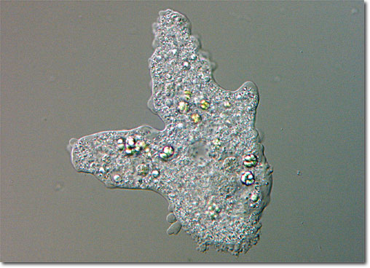
1. Be able to identify euglena, amoeba, paramecium and identify which kingdom they are classified in.
Amoeba
Paramecium
Euglena
http://www.fcps.edu/islandcreekes/ecology/Miscellaneous/Amoeba/amoebalarge.jpg

Slide 3
2. Be able to prepare % solutions
Add 1 gram of NaCl
To make a 1% of 100 mL:
100 x 0.01 = 1
Add 1 gram of NaCl in a beaker, and bring up to 100 mL in volume with water.
Bring up to 100 mL with water
How do you prepare a 5%, 100 mL NaCl solution?
How do you prepare a 9%, 100 mL NaCl solution?

Slide 4
3. Be able to recognize gall bladder and cheek cell epithelia; be able to recognize the nuclei and plasma membrane
Nucleus
Plasma Membrane
Gall Bladder
Cheek Cell

Slide 5
4. Be able to identify elodea, onion epidermis and potato tuber
Onion Cell
Elodea Leaf
Potato Tuber Cell

Slide 6
6. Identify chloroplast in elodea cells
Chloroplast

Slide 7
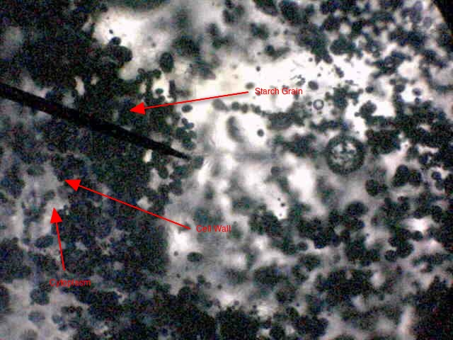
7. Identify the organelle that is stained with iodine; identify its function
Leucoplast
= starch storage
http://sternbioblock2.wiki.elanco.net/file/view/Good_HorningSnapshot_0004potato_starch.jpg/96479776/Good_HorningSnapshot_0004potato_starch.jpg

Slide 8
8. Be able to identify plant cells in a hypertonic or hypotonic solution
Hypertonic Solutions and Plant Cells
Elodea in 2% NaCl solution.
Elodea in 10% NaCl solution.
Leaf is in a 2% salt solution.
Chloroplast seen as nice, round circles.
Cell wall and plasma membrane are in tact.
Leaf is in a 10% salt solution.
Chloroplast appears deflated.
Cell wall is disrupted. Plasma membrane is deflated.

Slide 9
8. Be able to identify plant cells in a hypertonic or hypotonic solution
Hypotonic Solutions and Plant Cells
Elodea in 2% NaCl solution.
Elodea in 100% water.
Leaf is in a 2% salt solution.
Chloroplast seen as nice, round circles.
Cell wall and plasma membrane are in tact.
Leaf is in a 100% water.
Chloroplast still appear as round circles but are pushed to the sides.
Cell wall is slightly larger. Plant appears swollen and tighter. There appears to be more water inside the plant.

Slide 10
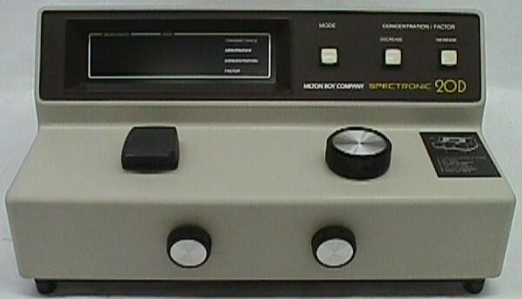
9/10. Be able to identify the parts and function of a spectrophotometer (functions of each part are described in page 96)
Mode
Sample Compartment
Wavelength Switch
Power Switch
Transmittance/Absorbance
Control
Filter
11. Describe the steps involved in measuring the absorption spectrum from a test tube containing chlorophyll (page 97)

Slide 11
13. Be able to interpret the color of an unknown substance from an absorption spectrum graph.
What wavelength of light is/are being absorbed from this chart?
What wavelength of light is/are being reflected from this chart?
Absorbance
Blue/Violet
Green
Red/Orange
Wavelength

Slide 12
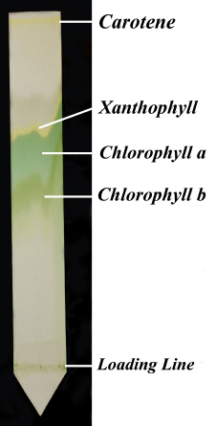
14. Identify various pigments that have been separated using paper chromatography
http://www.hsu.edu/uploadedImages/bachelors_degree/majors/Bachelor_of_Science/Biology/Nature_Trivia/Plants/Separation_of_Plant_Pigments_by_Paper_Chromatography/chromatograph1.jpg

Slide 13
15. Be able to indicate the phases of the cell cycle in an onion root cell
Interphase
Metaphase
Telophase
Prophase
Anaphase

Slide 14
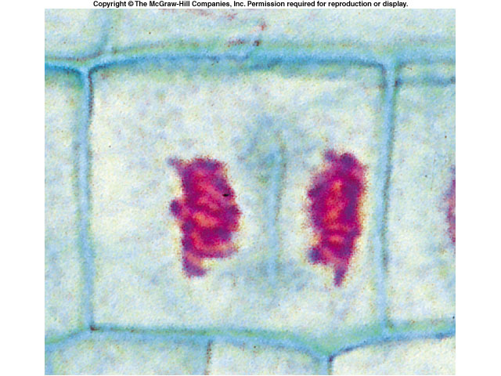
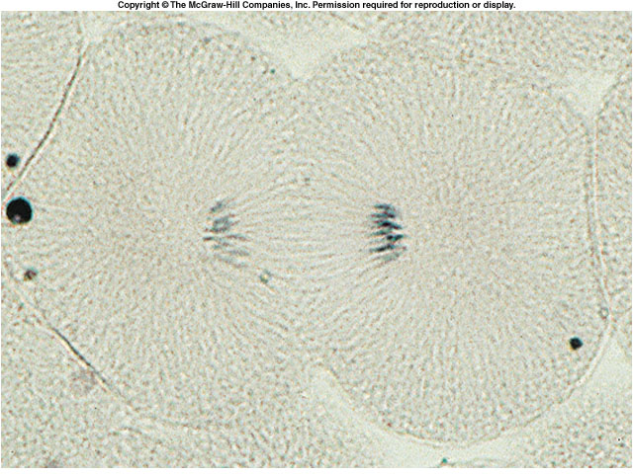
16. Be able to differentiate animal and plant cell cytokinesis
Plant Cell Plate Formation
Animal Cell Cleavage Furrow

Slide 15
17. Be able to determine the genotype of individuals in a pedigree
Male
Female
“Marriage”
Children
Daughter
Son
Fraternal
Twins
Identical
Twins
Are you able to determine the genotype of each individual shown on this pedigree? Assume that the shaded shapes above represent individuals who carry homozygous recessive alleles.

Slide 16
18. Be able to determine bacteria strains that carry antibiotic resistance
A
B
A
B
Regular LB agar plate
LB agar plate with Kanamycin
After 24 hours, the bacteria grew on the plate. Which strain was resistant to the antibiotic?

Slide 17
19. Be able to interpret data from a DNA agarose gel
The gel on the left shows DNA from a mock crime experiment:
Lane A = DNA retrieved from a mock crime scene
Lane B = DNA from suspect 1
Lane C = DNA from suspect 2
Lane D = DNA from suspect 3
Which of the three suspects likely perpetuated this mock crime?
Lane A
Lane B
Lane C
Lane D

