Slide 1
What you are turning in NOW…
Lab #2: The Scientific Method
Pre-Lab exercise (43 & 44) for completion
Lab #4: What’s in Our Food?
Pre-Lab exercise (79-81) and responses to
Lab Questions (83-86)
Lab #5: Dissection of the Fetal Pig Pre-Lab exercise to check for completion (95)

Slide 2
Due Next Week
Lab #2: The Scientific Method
Pre-Lab exercise for accuracy (43&44); Lab questions (45-54)
Lab #5: Dissection of the Fetal Pig
Pre-Lab exercise for accuracy (95)
Lab #6: The Kingdom Protista
Pre-Lab exercise check for completion (105)
March 13: Section 551

Slide 3
In TWO weeks
Bio 101 Lab PRACTICAL!!!
group ALPHA (6:45),
next time you will come in at 7:45.
group ZULU (7:45),
next time you will come in at 6:45.

Slide 4
Fetal Pig Dissection
Objectives:
Observe the anatomy of a fetal pig
Anatomy of the fetal pig is very similar to that of a human
FYI:
The pigs did not feel any pain during preservation. They are the byproducts of the pork industry and would have been discarded.

Slide 5
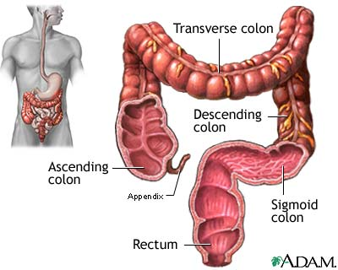
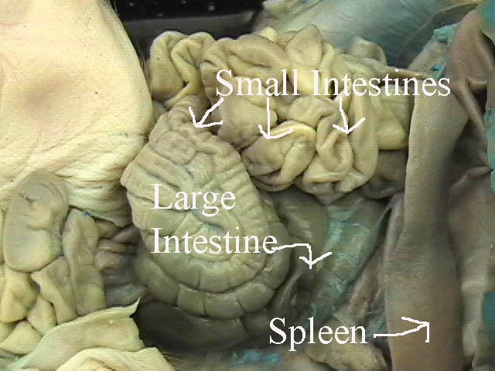
Some things to consider:
The liver is proportionally larger in a pig than in a human.
The large intestine in a pig is coiled; the large intestine in a human is stretched out.
http://edweb.fdu.edu/folio/banborv/FPdissection/small%20and%20large.jpg
http://www.nlm.nih.gov/medlineplus/ency/images/ency/fullsize/19220.jpg

Slide 6
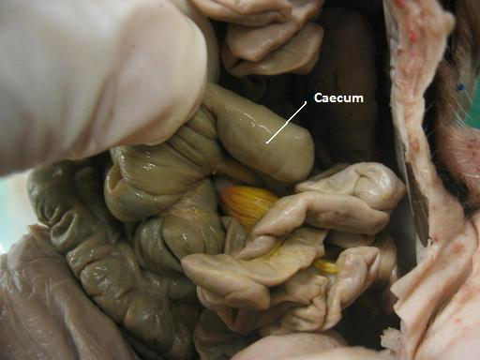
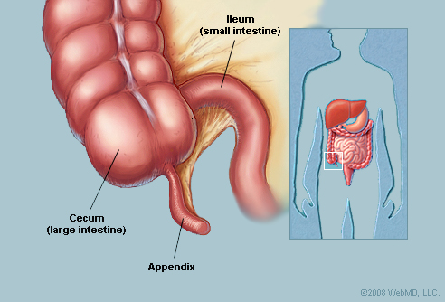
Some things to consider:
3. A small sac called caecum exists in a pig.
This sac is similar to the appendix in a
human.
http://bio628.wikispaces.com/file/view/DLHC-PIG-Caecum.JPG/34492989/DLHC-PIG-Caecum.JPG
http://img.webmd.com/dtmcms/live/webmd/consumer_assets/site_images/articles/image_article_collections/anatomy_pages/appendix3.jpg

Slide 7
Let’s see what’s inside!!!
Every group of 4 students
will dissect a pig.
You will have to know the
name of the different organs
outlined in your book (92-94).

Slide 8
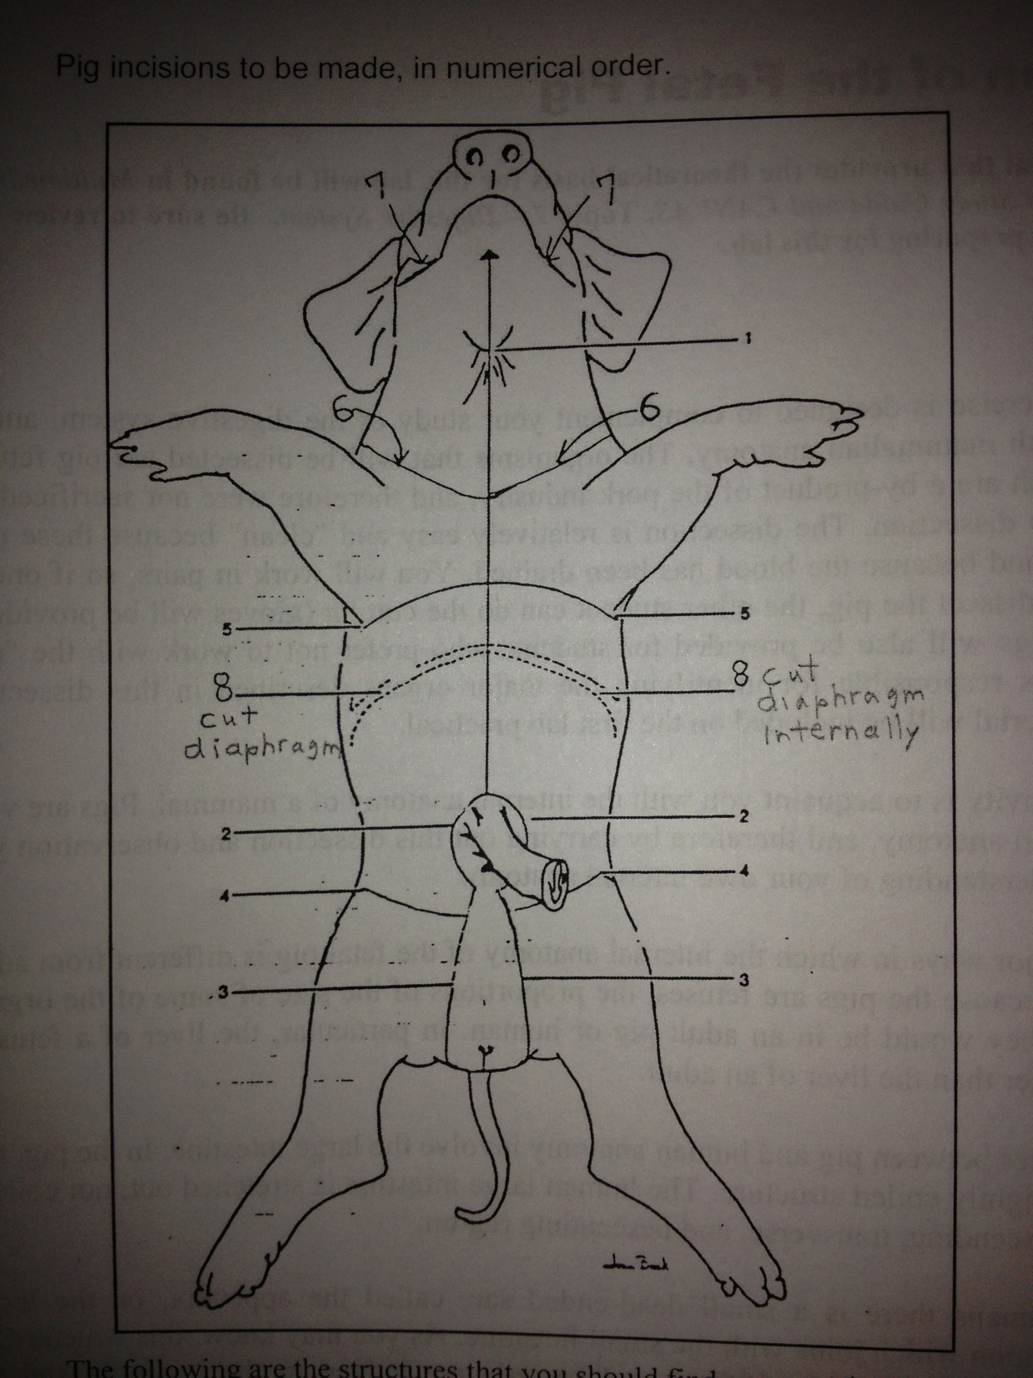
Be sure that you
make the
incisions in
THIS order
SHARE the task
of investigation/
extraction

Slide 9
Let’s get to WORK!!!
Part I we will work on together! These for the most part are new concepts.
If the class is moving a bit too slow
for you, please feel free to look over the next part of the lab or
work on the pre-lab for next week.

Slide 10
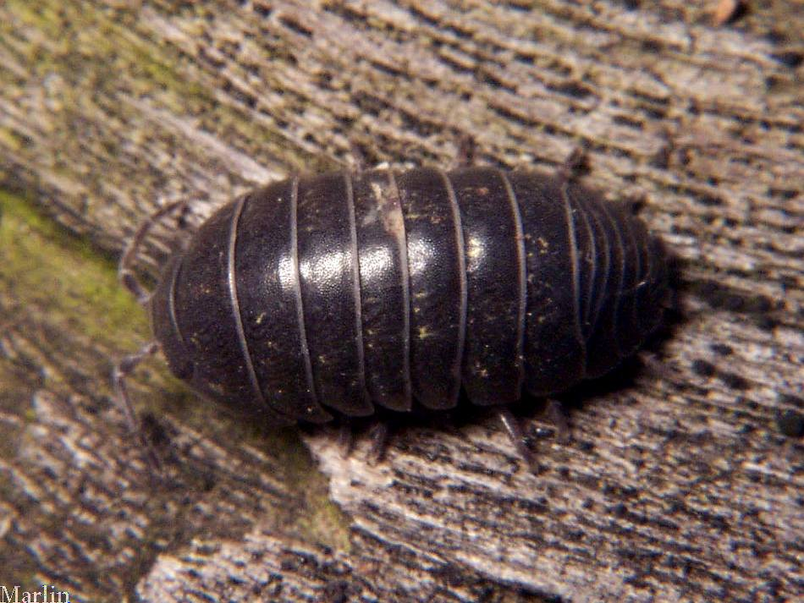
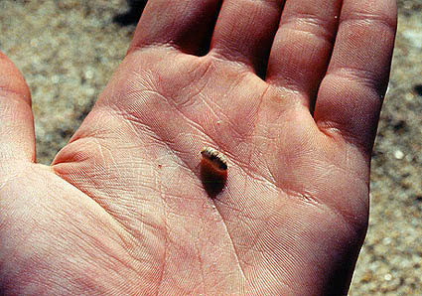
http://www.cirrusimage.com/Isopoda/pillbug_08.jpg
Copyright © 2005 Marine Discovery

Slide 11
Scientific name: Armadillidium vulgare
Kingdom: Animalia
Belongs to the order Isopoda, a family of woodlice
Only crustacean that is able to spend its lifetime on land
Folds itself into a small as a defense mechanism or response to vibration or pressure
Live in wet locations and are often found in damp environments
Have gill-like structures that extract oxygen from its environment; but cannot live under water!

Slide 12
The Great Pillbug Experiment!
Pillbugs are found under objects on damp ground. You might wonder what attracts the pillbugs to that environment – is it the moisture, darkness, or both moisture and darkness, or some other factor?
In this lab you will form and test hypotheses regarding this question.

Slide 13
Hypothesis: Pillbugs are not attracted to or repelled by dark (Null hypothesis)
Experimental Design
Subject: 20 pillbugs
Experimental Variable: Shaded part of the pan
Controlled Variable: Metal pan, atmosphere is dry
Dependent Variable: Migration to a specific part of the pan
Expected/Predicted Result:
There will be a 50/50 ratio of the pillbugs in the dark or the light.
Observed Result:
8 pillbugs went to the light part, 12 pillbugs went to the dark part.

Slide 14
χ² (Chi Square) – Goodness of Fit Test
Advantages:
Can be used to test the difference between an actual sample (actual data) and hypothetical expectations (expected outcome from a hypothesis)
Used to test the difference between what you expect to find from an experiment, and what you actually find from an experiment
Examine differences in data between categories
Very easy to calculate!!!
Disadvantages:
Can only be used on raw data that is counted (cannot be used for measurements, proportions or percentages)
A type of nonparametric statistics and is not as powerful as other types of statistical methods

Slide 15
χ² (Chi Square) – Goodness of Fit Test
Χ² (Chi Square) = ∑
(Observed Frequency – Expected Frequency)²
Expected Frequency
∑ = expression of a sum of values of variables
Observed frequency = actual data that is observed
Expected frequency = data that is expected

Slide 16
Hypothesis: Pillbugs are not attracted to or repelled by dark (Null hypothesis)
Data:
Expected ratio of light/dark = 10/10
Observed ratio of light/dark= 8/12
Class | Observed Number (O) | Expected Probability | Expected Number (E) | O-E | (O-E)² | (O-E)² E
Light |  | 50%
Dark |  | 50%
Total | 20 | 100% | 20
 |  |  |  |  |  | χ²=
So what does this χ² value mean???

Slide 17
Hypothesis: Pillbugs are not attracted to or repelled by dark (Null hypothesis)
Data:
Expected ratio of light/dark = 10/10
Observed ratio of light/dark= 8/12
Class | Observed Number (O) | Expected Probability | Expected Number (E) | O-E | (O-E)² | (O-E)² E
Light | 8 | 50% | 10 | -2 | 4 | 0.4
Dark | 12 | 50% | 10 | 2 | 4 | 0.4
Total | 20 | 100% | 20
 |  |  |  |  |  | χ²= 0.8
So what does this χ² value mean???

Slide 18
Interpretation of the value is base on χ² Distribution Table:
df (degrees of freedom)
= # of parameters/value that are allowed to vary
= (number of classes – 1)
p-value (probability) = expresses whether the differences between what is observed and what is expected is due to chance
In most cases a p-value less than 5% (p<0.05) describes statistical difference between what is observed and what is expected.
Hypothesis: Pillbugs are not attracted to or repelled by dark (Null hypothesis)
QUESTIONS:
Is there a difference between the number of pillbugs in the light/dark we predicted, and the actual number of pillbugs in the light/dark we observed?
Should be reject or accept our hypothesis?
No. The p-value is greater than 5%. There is no statistical difference between the hypothesis and the observation.
ACCEPT!

Slide 19
Hypothesis: Pillbugs are attracted to the dark.
Experimental Design
Subject: 20 pillbugs
Experimental Variable: Shaded part of the pan
Controlled Variable: Metal pan, atmosphere is dry
Dependent Variable: Migration to the dark part of the pan
Expected/Predicted Result:
All of the pillbugs will stay in the “dark” part of the pan.
Observed Result:
8 pillbugs went to the light part, 12 pillbugs went to the dark part.

Slide 20
Hypothesis: Pillbugs are attracted to the dark.
Data:
Expected ratio of light/dark = 0/20
Observed ratio of light/dark= 8/12
Class | Observed Number (O) | Expected Probability | Expected Number (E) | O-E | (O-E)² | (O-E)² E
Light |  | 0%
Dark |  | 100%
Total | 20 | 100% | 20
 |  |  |  |  |  | χ²=
So what does this χ² value mean???

Slide 21
Hypothesis: Pillbugs are attracted to the dark.
Data:
Expected ratio of light/dark = 0/20
Observed ratio of light/dark= 8/12
Class | Observed Number (O) | Expected Probability | Expected Number (E) | O-E | (O-E)² | (O-E)² E
Light | 8 | 0% | 0 | 8 | 64 | 0
Dark | 12 | 100% | 20 | -8 | 64 | 3.2
Total | 20 | 100% | 20
 |  |  |  |  |  | χ²= 3.2
So what does this χ² value mean???

Slide 22
Interpretation of the value is base on χ² Distribution Table:
df (degrees of freedom)
= # of parameters/value that are allowed to vary
= (number of classes – 1)
p-value (probability) = expresses whether the differences between what is observed and what is expected is due to chance
In most cases a p-value less than 5% (p<0.05) describes statistical difference between what is observed and what is expected.
Hypothesis: Pillbugs are attracted to the dark
QUESTIONS:
Is there a difference between the number of pillbugs in the light/dark we predicted, and the actual number of pillbugs in the light/dark we observed?
Should be reject or accept our hypothesis?
Yes; but the p-value is greater than 5%. There is not enough statistical difference between the hypothesis and the observation.
REJECT!

Slide 23
Let’s get to WORK!!!
Part II you will work on without my direct assistance. If/when you have any questions, be sure to ASK!
I might not give you the answer you wanted, but I’ll certainly help you in the thinking process…

Slide 24
Rules for the lab practical:
Bring a pencil or a pen ONLY.
All bags will be placed on the front of the classroom. No phones, no music players, no hats, nothing in your pockets.
You will receive an answer sheet with 25 spaces for your answers.
4. You are free to answer each question on any
available station. No two students on the
same station at the same time.

Slide 25
Rules for the lab practical:
You are free to leave after you finish the test.

Slide 26
Know the parts of the microscope.
Understand the difference between resolution vs. magnification.
Magnification = how large an object appears
Resolution = how clear/resolved an object appears
Total magnification = ocular lens x objective lens
What is the total magnification of a specimen viewed with a 40x objective lens?
(10x) x (40x) = 400 x total magnification
3. Know the different microscopes discussed in class.

Slide 27
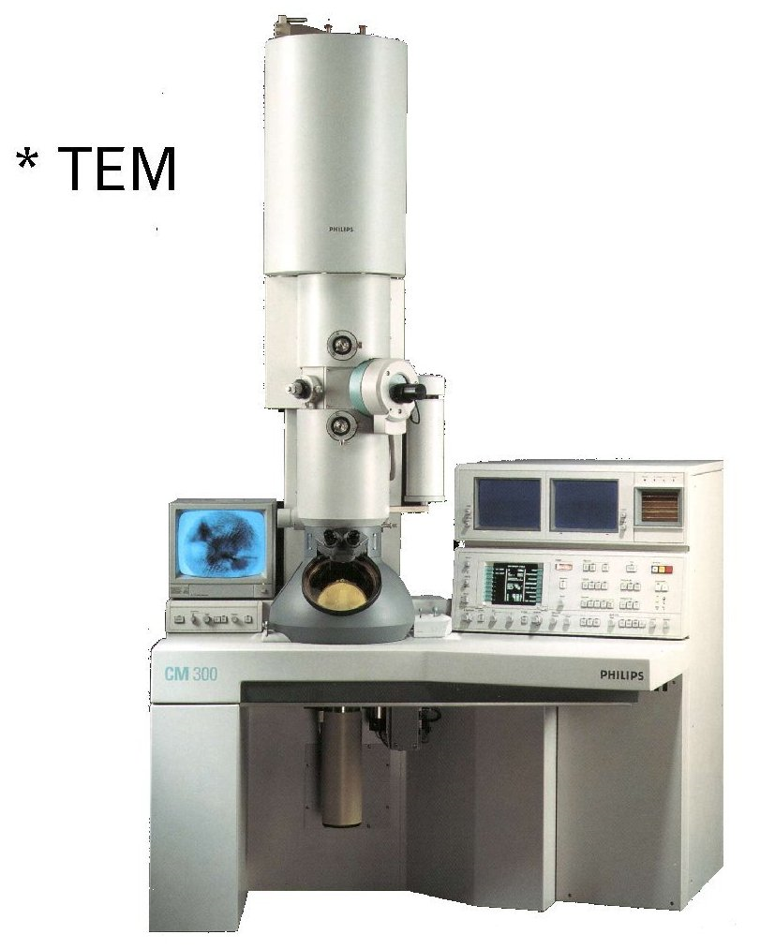
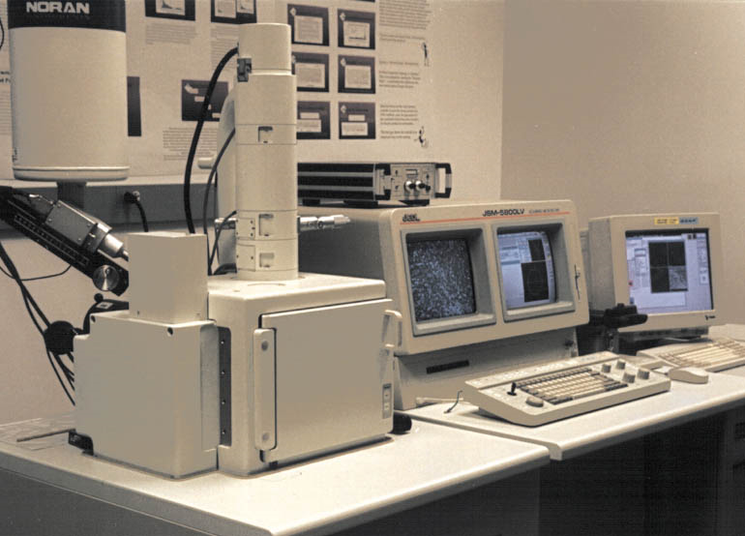
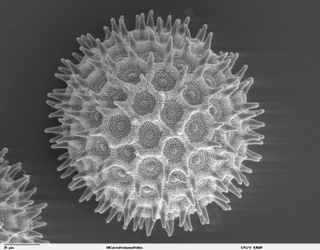
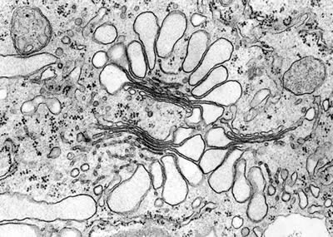
SEM
http://serc.carleton.edu/research_education/geochemsheets/techniques/SEM.html
http://serc.carleton.edu/research_education/geochemsheets/techniques/SEM.html
http://www.brookes.ac.uk/lifesci/research/groups/researchimages/plantcellbiologyimage/golgitem
http://bayblab.blogspot.com/2008/07/sem-pics.html

Slide 28
5. Which of the following total magnification will allow you to see a “bigger field of view” in the microscope?
6. Which of the following total magnification will allow you to see a bigger/enlarged view of a specimen?
7. Know your units!!!
Know conversion between millimeter (mm) to micrometer (μm)
8. Know what is p-value.
What does the p-value represent?
Are you able to find the p-value if given a Chi-square value for an experiment?
Do you accept or reject data base on a p-value alone?
1x objective
10x objective
1x objective
10x objective

Slide 29
Hypothesis: Pillbugs are not attracted to or repelled by dark (Null hypothesis)
Data:
Expected ratio of light/dark = 10/10
Observed ratio of light/dark= 8/12
Class | Observed Number (O) | Expected Probability | Expected Number (E) | O-E | (O-E)² | (O-E)² E
Light | 8 | 50% | 10 | -2 | 4 | 0.4
Dark | 12 | 50% | 10 | 2 | 4 | 0.4
Total | 20 | 100% | 20
 |  |  |  |  |  | χ²= 0.8

Slide 30
NOT SIGNIFICANT
SIGNIFICANT
Hypothesis: Pillbugs are not attracted to or repelled by dark (Null hypothesis)
Is there a difference between the number of pillbugs in the light/dark we predicted, and the actual number of pillbugs in the light/dark we observed?
Should be reject or accept our hypothesis?
No. The p-value is greater than 5%. There is no statistical difference between the hypothesis and the observation.
ACCEPT!

Slide 31
9. What is pH?
- pH is the negative log of [H]
- pH measures the concentration of H and OH ions in solution.
10. What is the [H] of a solution that is at pH 6? What would be the [OH] of this solution?
[H] = 1x10⁻⁶ M
[OH] = 1x10⁻⁸ M
11. If a solution at pH 1 is diluted by 1/10 with pure water, what will be its new pH?
pH 2

Slide 32
12. Know how to interpret the results of the following:
a. pH strip
Are you able to interpret the result of a pH strip?
b. conductivity meter
What types of solutions should “light up” from a conductivity meter?
Ionic solutions (salt solutions, acid solutions, alkaline solutions)
13. Know how to make a molar solution.
1 M solution of NaCl.
Na = 23 g/mol
O = 35 g/mol
Add 58 grams of NaCl in a beaker
Fill or top up beaker with 1 L of water

Slide 33
Below
pH7
Above pH7
14. What is phenol red?
Color indicator
15. Know the food tests!!!
Benedict’s Solution:
Tests for the presence of
monosaccharides/reducing sugar.
Iodine test:
Tests for the presence of starch.
pH7

Slide 34
Sudan IV test
Tests for the presence of lipids
NaoH and CuSO4 test
Tests for the presence of amino acids
(peptide bonds)
Vitamin C test/Indophenol
Tests for presence of Vitamin C

Slide 35
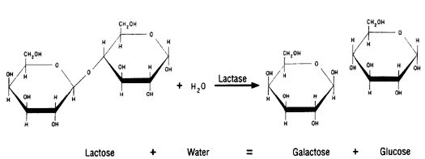
15. Lactose vs. lactose-free milk
http://www.food-info.net/images/lactase.jpg
How would you interpret a sample of milk that tests positive for glucose?
16. Know ALL the parts of the pig as listed in your lab manual.

Slide 36
Study Guide for lab practical is in your lab book (87, 97 & 98)

